Slide 1
Managerial Accounting
Chapter 10
ACT 205 – Fundamentals of Accounting

Slide 2
ACT 205 – Fundamentals of Accounting
Chapter 1: Introduction to Financial Statements
Chapter 2: A Look at Financial Statements & Financial Statement Analysis
Chapter 3: The Accounting Information System
Chapter 4: Accrual Accounting Concepts
Exam 1
Chapter 5: Fraud, Internal Control, and Cash
Chapter 6: Recording and Analyzing Merchandising Transactions, A/R, Inventory
Chapter 7: Long-Lived Assets
Exam 2
Chapter 10: Managerial Accounting
Chapter 11: Cost-Volume-Profit
Chapter 13: Budgeting
Chapter 16: Planning for Capital Investments
Exam 3
Chapter 8: Liabilities and Equity
Final Exam

Slide 3
Part 1: Financial Accounting
Income Statement
Revenues
Less Expenses
= Net Income
Other Comprehensive Income
Statement of
Changes in Shareholders’
Equity
Common Stock
Retained
Earnings
Statement of
Cash Flows
Operating
Investing
Financing
Balance Sheet
Assets = Liabilities + Shareholders’ Equity
Cash Chp. 5
Accounts Receivable Chp. 6
Inventory Chp. 6
Long Lived Assets Chp. 7
Liabilities Chp. 8
Equity Chp. 8
The Accounting Process – Chapters 1,2,3,4

Slide 4
Part 2: Managerial Accounting
Terms
Chapter 10
Cost-Volume-Profit Analysis
Chapter 11
Incremental Analysis
Chapter 12
Budgetary planning
Chapter 13
Net Present Value
Internal Rate of Return
Chapter 16
Tools to assist management in decision making and evaluating those decisions

Slide 5
Learning Objectives
To identify managerial terms
To compute Cost of Goods Manufactured to Completion
To identify ethical concerns

Slide 6
Managers’ Activities
Planning
Budgeting
13
Capital Investments
16
Cost Behavior
11
Controlling & Evaluating (Directing)
Special Decisions 12
Cost Concepts 10

Slide 7
Managerial Accounting
Aids Internal users
In Making decisions
Uses economic, financial and nonfinancial information
Gathers useful data only if it adds value in excess of its costs

Slide 8
Terms – Start using these terms
Relevant cost -
Opportunity cost -
Sunk costs –
Period costs -
Product costs –
3 Product costs –
Manufacturing Overhead costs (MOH) –
3 Inventory costs-

Slide 9
Key Managerial Terms
Relevant cost
Costs that differ across alternative. (in decision making - ignore costs that do not differ among alternatives)
Opportunity Cost
A lost benefit when management chooses one course of action over another
Sunk Cost
Costs that have already been incurred and will not be changed or avoided by any present or future decisions Ignore – as they are not relevant

Slide 10

2 Key Terms THIS Chapter
Product Costs – costs necessary in producing a finished product (factory costs)
2. Period Costs – costs that relate to a period, and are expensed in the period so matched with revenue (office costs, administrative costs, sales & marketing costs)

Slide 11
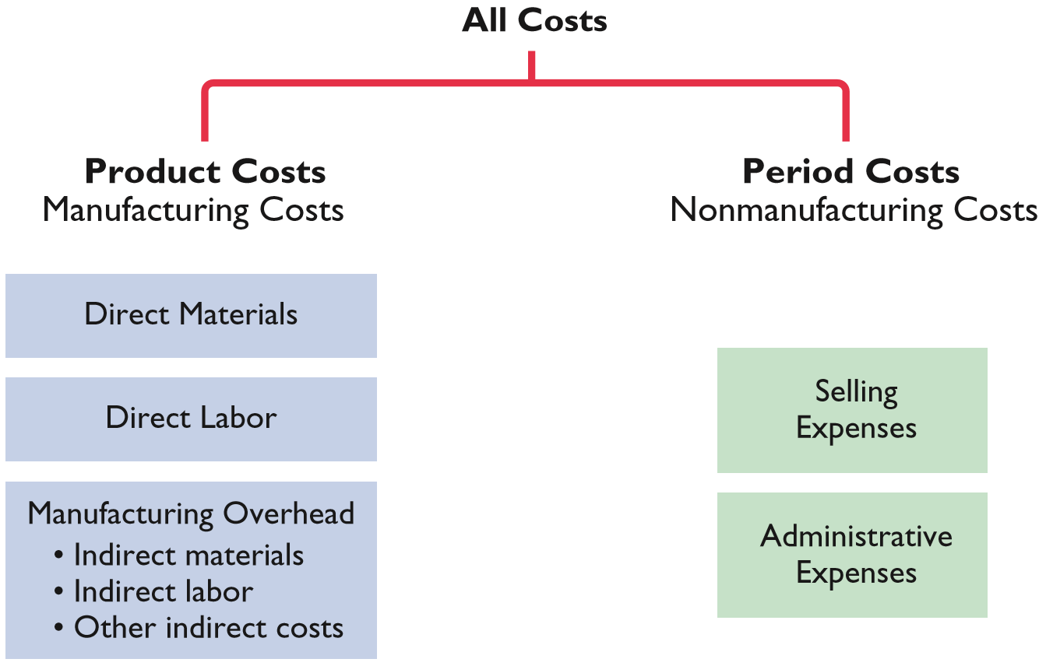
PRODUCT VERSUS PERIOD COSTS

Slide 12



Three Components of Product Costs
Materials
Labor
Overhead

Slide 13
Costs Can Be an ASSET (Inventory) or an Expense
Product Cost
Asset 1st
COGS
when sold
Period Cost
Expense
Right away

Slide 14
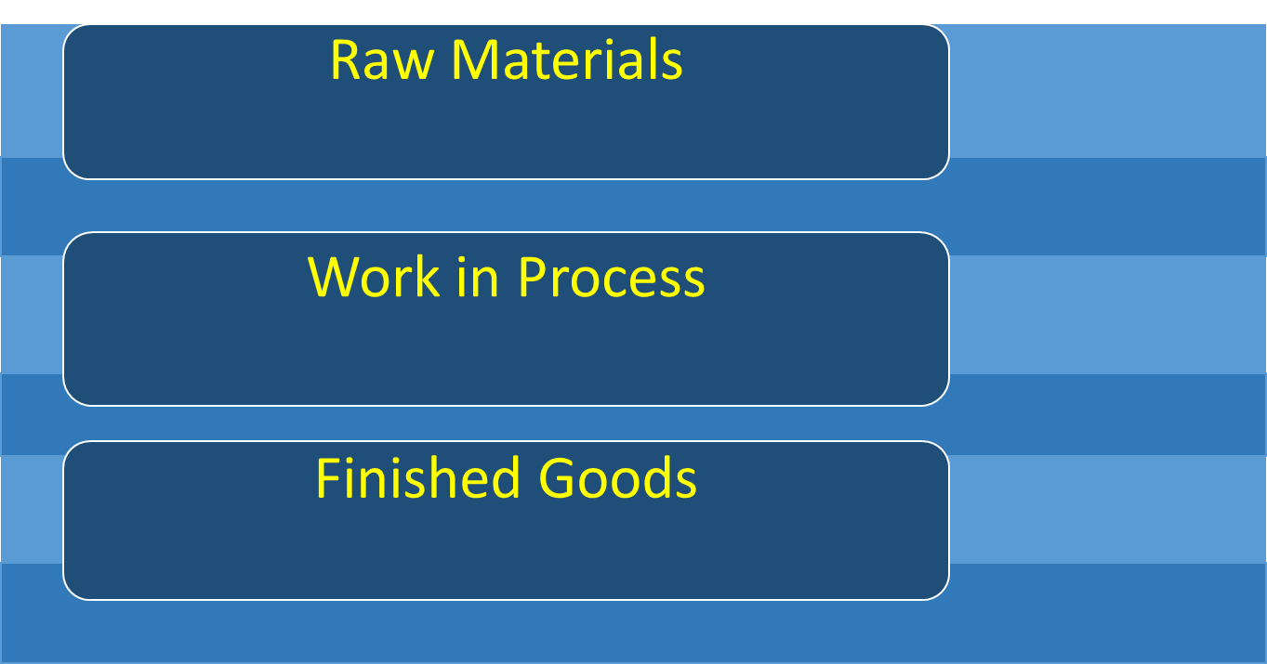
Manufacturing - Three Inventory Accounts
Materials used to make products
Partially completed products
Completed products ready to sell

Slide 15

Manufacturing Overhead Costs Relate to the Factory
Indirect Costs
Depreciation
Supervisor’s Salary
Utilities

Slide 16
Total Manufacturing costs
Direct
Materials
Direct
Labor
INDIRECT
Manufacturing
Overhead (MOH)
Raw material
costs that can
be easily traced
to products.
Factory wages
that can be easily
traced to products.
Other factory costs
such as indirect
materials and labor,
utilities, rent, security,
and depreciation.

Slide 17
Terms next Chapters
Variable Costs – costs that change in total related to changes in activity level, constant on a per unit basis
Fixed Costs – costs that remain unchanged in total regardless of changes in activity level
Mixed Costs – costs with both variable and fixed components

Slide 18
Terms next Chapters
Sunk Costs – costs that cannot be changed by any future decision
Relevant Costs – costs that differ across alternatives
Opportunity Costs – potential benefit lost by choosing one course of action over another

Slide 19
Terms next Chapters
Contribution margin– revenue less variable costs
Break-Even point– activity level at which revenue=costs
Target Net income– the income objective set by management
Value Chain – all business processes needed to make a product

Slide 20
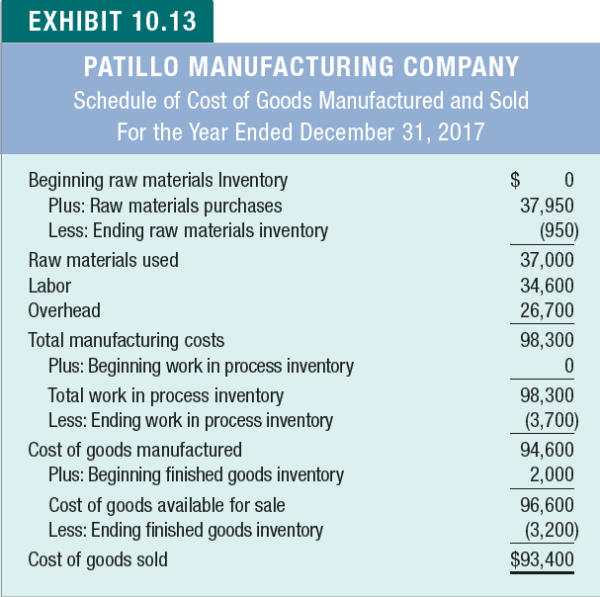
Cost of Goods Manufactured – KEY Schedule
The Schedule of Cost of Goods Manufactured to completion summarizes product cost information
Appears on Income Statement

Slide 21
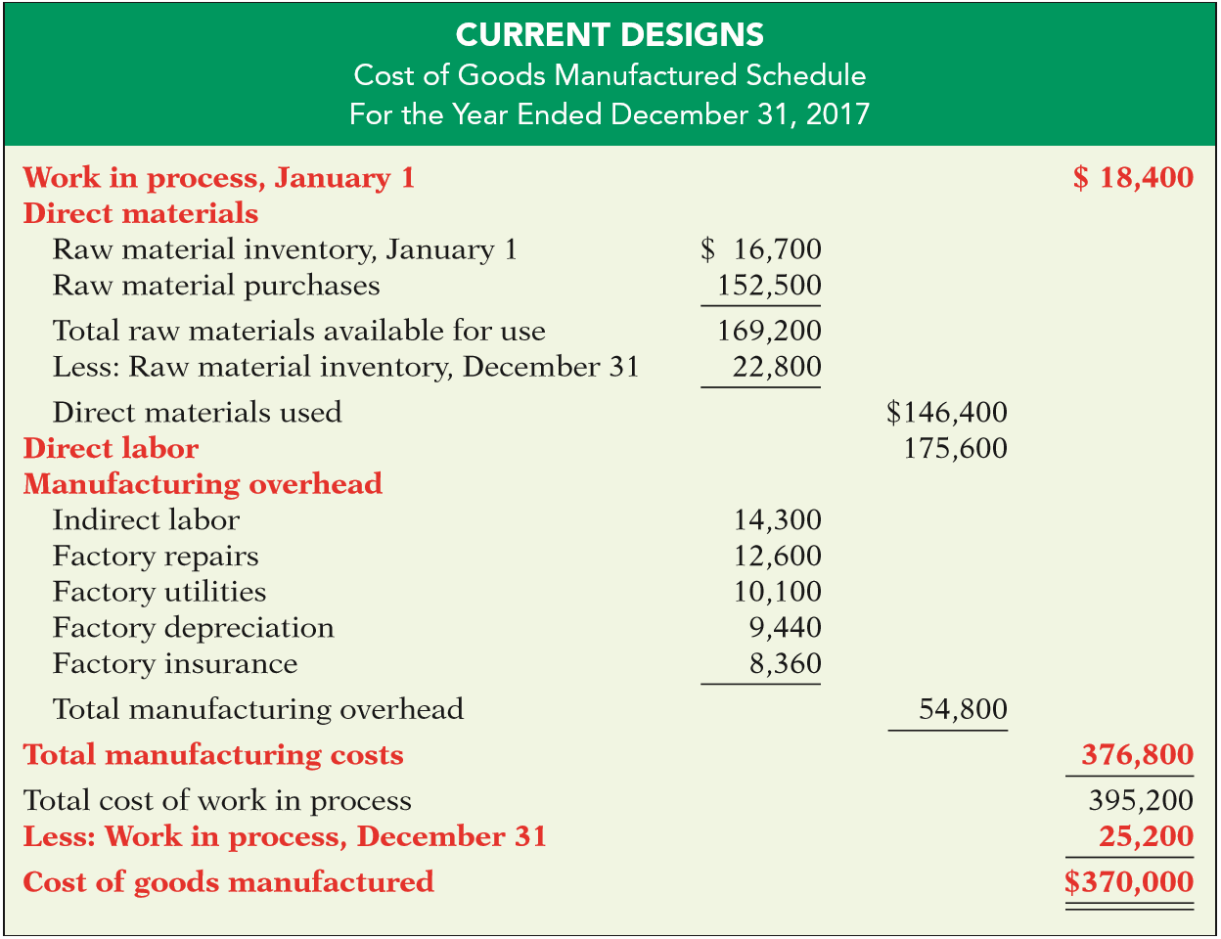
Of the 3 Inventory accounts: which are on this schedule?
WIP and ???

Slide 22
Ethical Considerations are Important in Managerial Accounting
Certified Management Accountants are guided by the IMA Statement of Ethical Professional Practice
Standards are:
  Competence
  Confidentiality
  Integrity
  Credibility
  Resolution of ethical conflict

Slide 23
Problems
I do: P10-2, P10-4
You do: P10-1, P10-5

